Slide 1


Slide 2

#LifeKoKaroLift
SGC Coaching:
Articulate your Journey | Activate Your Vigour| Accelerate Mutual Growth
Session 17
Neural Network

Slide 3
Agenda
Quick Recap – (15 min)
Focused Teaching (60 min)
Doubts Resolutions (15 min)
Neural Network
doubts resolutions
Last 2 weeks

Slide 4
Recap: What the learner have learnt in the week
Quick Glance at Key Learnings
Neural Network
Forward Propagation
Backward Propagation
Basics
When to use
What is
When to use
What is
Basic Understanding

Slide 5
Focus Teaching – Deep Learning
Traditional Machine learning
Input
Feature Engineering
Classification Model
Output
Deep Learning
Input
Feature Engineering + model
Output
Notes:
Much of the statistical theory relies on the data being independent and identically distributed
Series often change with time, so bigger isn’t always better

Slide 6
Focus Teaching – Deep Learning
Input layer
Hidden layers
Output layer
Ground truth
1st
2nd
Last
W
W
W
W
W
W
W
W
W
W
W
W
W
Notes:
Neural Network Architecture

Slide 7
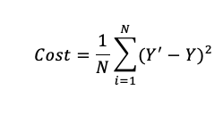
Focus Teaching – Deep Learning
Cost function
Its measures the performance of a Machine Learning model for given data. Cost Function quantifies the error between predicted values and expected values and presents. it in the form of a single real number.
It vary as per the change in weights & biases. If we have correct weights & biases, we have minimum cost function value. Our end goal is to find the correct combination of weights & biases.

Slide 8
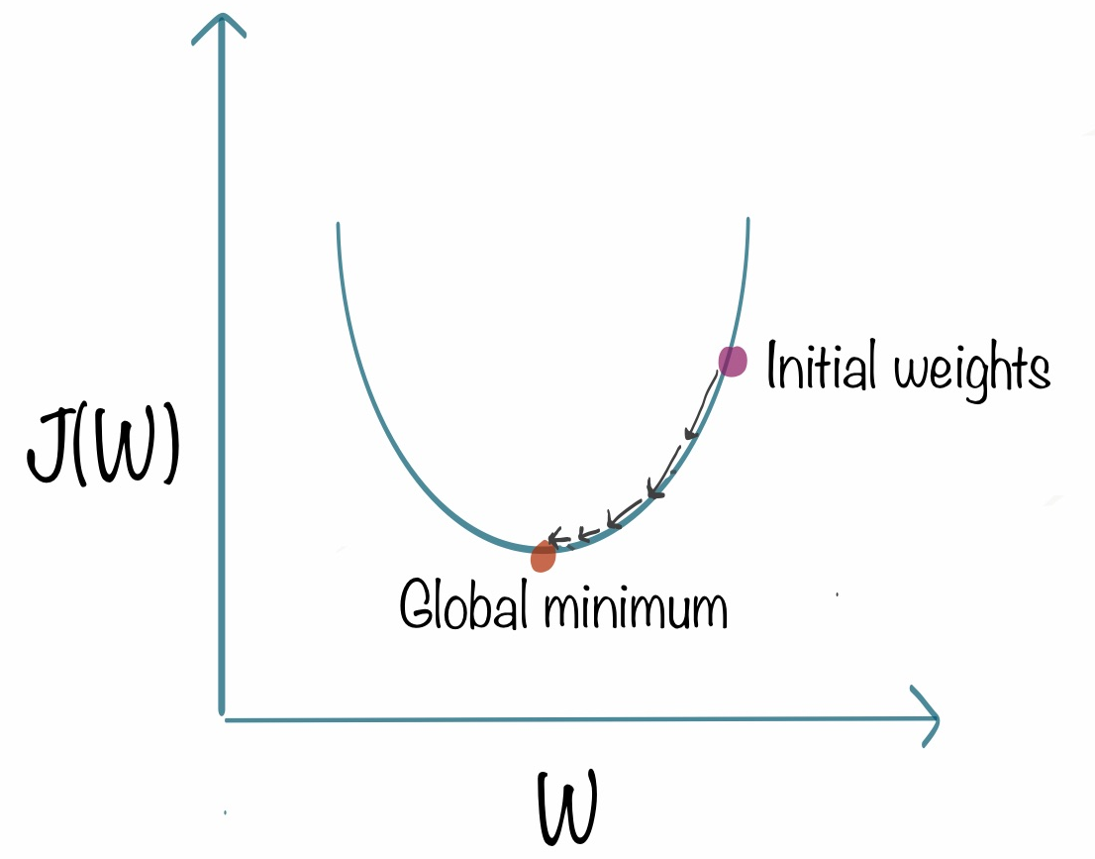

Focus Teaching – Deep Learning
Gradient Descent
Its impossible to get all combination of weights & biases. We are using calculus help to get it.

Slide 9
Coding Time
Coding Time
Notes:
Coding time

Slide 10

Doubts Resolutions

